Slide 1
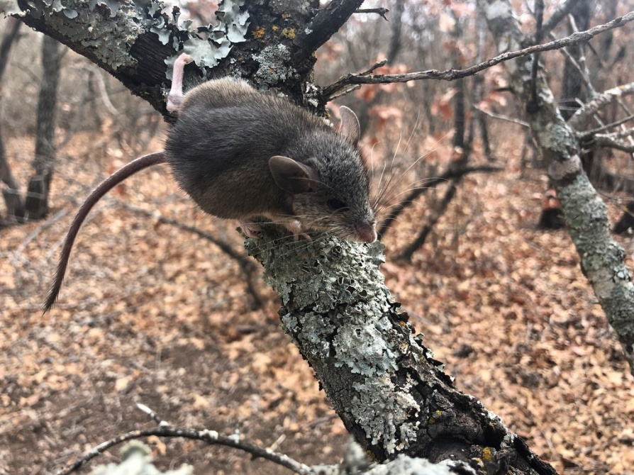
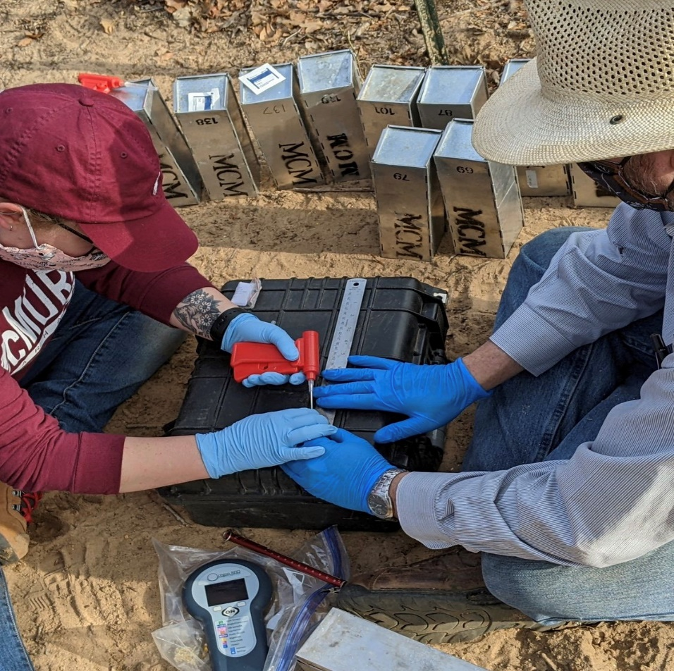
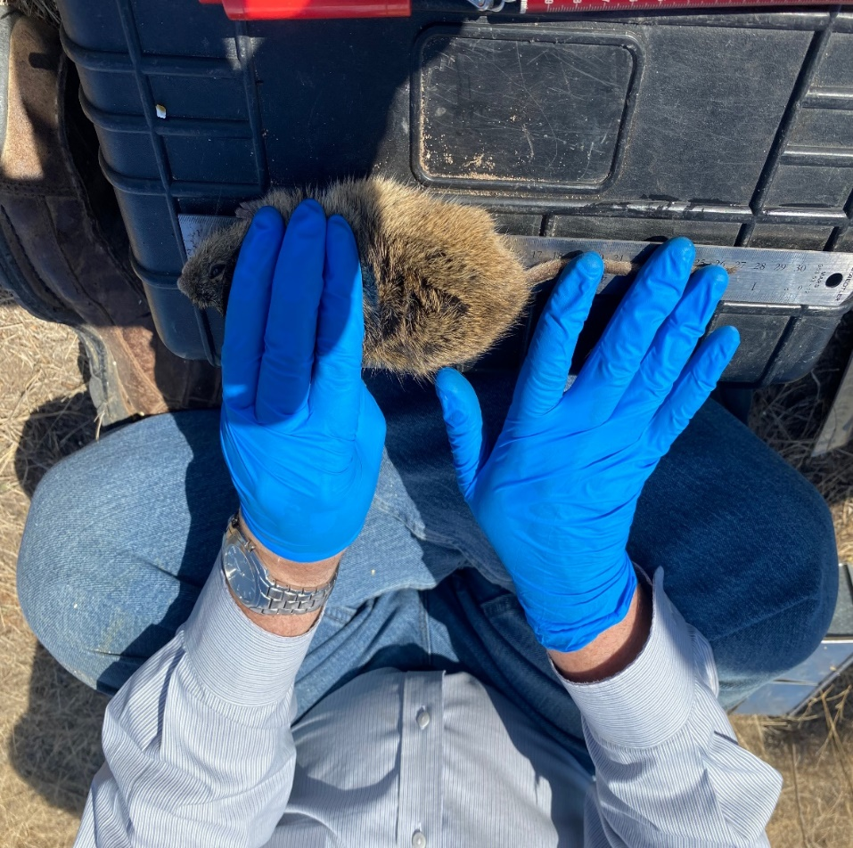
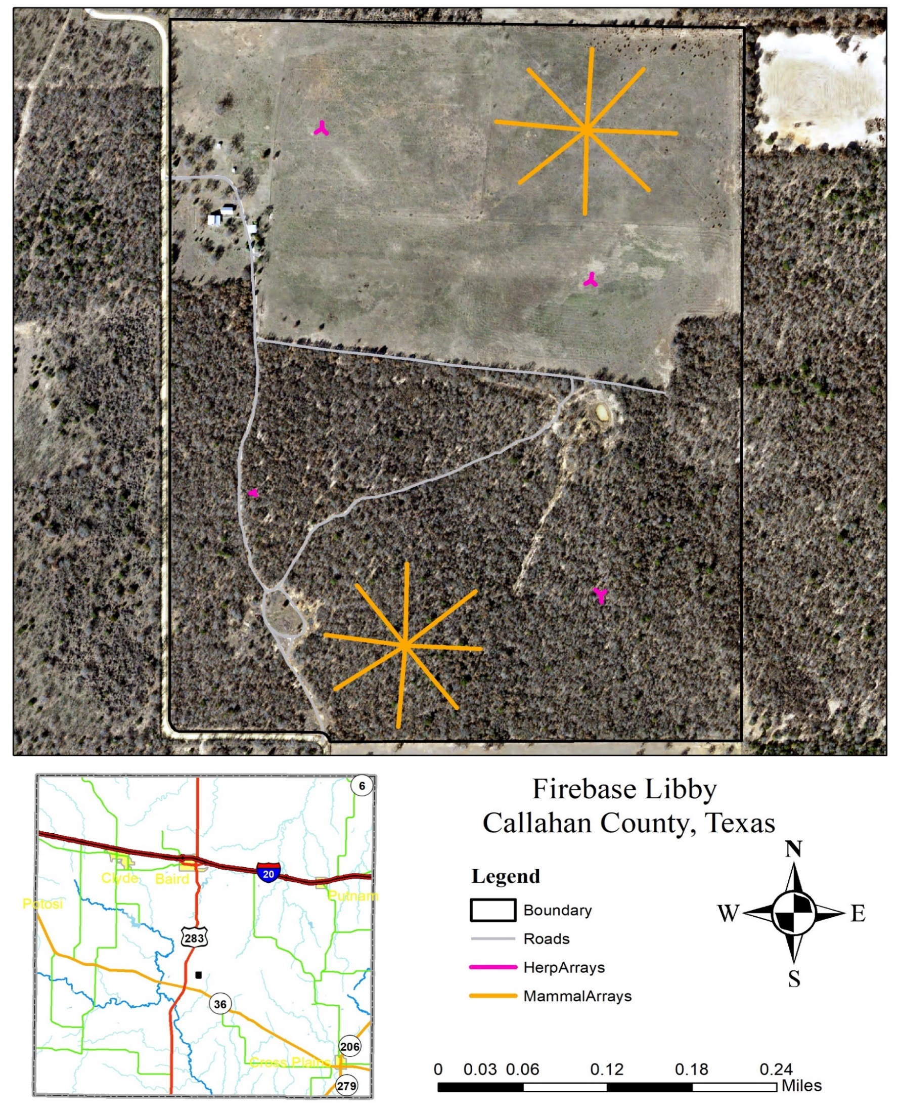
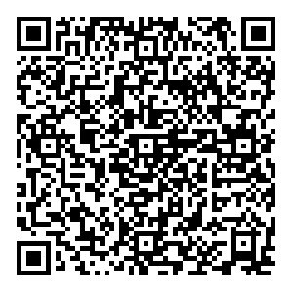
Biodiversity Assessment and Estimation of Population Density of
Rodents at Firebase Libby, Callahan County, Texas
Luke Marshall, Bricelynn Sikes, and Joel G. Brant Department of Biology, McMurry University
Brant Scouts
Introduction
Small mammals such as mice are a linkage species; a link between plants they consume and carnivores that predate them. Tracking the diversity of small mammals within a habitat can provide a better understanding of the health of that ecosystem and the important roles they play in shaping the ecosystem (Schmidly & Bradley, 2016). The big country region of Texas is poorly assessed when it comes to mammal populations. Outside of several publications reporting county records no systematic survey of mammals in this region has been published (Hanson et al. 1998; Campbell et al., 2002; Goetze and Nelson, 2009; Lee et al. 2010). A more systematic effort to assess the population and community diversity of mammals in this region would aid in understanding the ecological impacts of changes in the environment.
Objectives
Trap and identify small mammal species at Firebase Libby
Evaluate mammal diversity in each habitat
Estimate population densities
Peromyscus attwateri dominates the wood habitat.
The grass habitat is more diverse than the wood habitat.
There are ~20 Peromyscus attwateri per wooded acre.
Materials and Methods
One trapping weekend (2 nights) per month.
Two mammal arrays: one in the grass habitat and the other in the wood habitat.
20 Sherman traps in each cardinal direction (160 at each array total).
Any mice caught are sexed, measured, weighted, checked for RFID chip, and species determined. Recaptured animals are returned to the location they were captured. Newly trapped animals, are tagged with an RFID and then released where they were captured.
Population densities were estimated via Mark software using the Cormack-Jolley-Seber model (phi(.)/p(.) model).
Diversity indices were calculated using MatLab 6.0. Significance was calculated via iterative resampling.
A
B
C
Figure 2: Numbers of rodents captured at Firebase Libby.
Figure 5: Density of Peromyscus attwateri in wooded habitat at Firebase Libby.
Figure 8: Three of the rodent species encountered at Firebase Libby: (A) Peromyscus attwateri (B) Reithrodontomys fulvescens (C) Baiomys taylori
A
B
Figure 3: Diagram of the captures on a single individual over the course of 17 months.
Figure 9: Processing new individuals: (A) injecting a mouse with an RFID tag and (B) measuring a Sigmodon hispidus.
Figure 6: Density of Reithrodontomys fulvescens in grass habitat at Firebase Libby.
Acknowledgements
We would like to thank McMurry University Biology Department and the Title V office for access to Firebase Libby and for funding this research. Fellow Brant scouts for their assistance in trapping and data collection. Special thanks to Rev. Libby for donating the property and providing us the opportunity to conduct this research.
Literature Cited
Campbell, C. A., T. E. Lee, Jr., & A. J. Landwer. 2002. Noteworthy records of mammals from the Rolling Plains of Texas. Texas J. Sci., 54(4):365-368.
Goetze, J. R., & A. Nelson. 2009. First records of 13 mammalian species within the southwestern Cross Timbers Region of Texas. Occas. Pap. Mus., Texas Tech Univ., 284:1-6.
Hanson, J. D., C. E. Peden, & T. E. Lee, Jr. 1998. Records of Species and range extensions of mammals in Taylor County , Texas. Texas J. Sci; 50(3):251-255.
Lee, T. E., J. G. Brant, H. E. Rainer, & J. D. Thompson. 2010. Additional records of mammals from the southern rolling plains. Texas J. Sci., 62(4):305-307.
Schmidly, D. J., & R. D. Bradley. 2016. The Mammals of Texas. The University of Texas Press.
Figure 4: Diagram of the 26 Peromyscus attwateri captured in March 2022.
Table 1: Diversity data for each habitat with the p-level of significance being .05, and the red values in red being significant
Total
 | Wood Habitat | Grass Habitat | p-value | Total
Richness | 2.9046 | 2.3977 | 0.5220 | 3.2613
Dominance | 1.2356 | 2.1200 | 0.0040 | 2.7644
Evenness | 0.1845 | 0.4760 | 0.0010 | 0.4241
Diversity | 0.2853 | 0.6181 | < 0.0001 | 0.7179
Figure 1: Map of Firebase Libby and Locations of Trapping Arrays on the Property.
Scan this QR code for a brief video from August 2020 describing the methods for this project as well as some preliminary results.
Figure 7: Density of Baiomys taylori in grass habitat at Firebase Libby.

